Slide 1
Africa
Today we will learn about the geography of Africa.

Slide 2
North Africa
Includes Morocco, Tunisia, Algeria, Libya, Egypt and Sudan.
Mostly Arab People.
Religion primarily Islam.
Wealth from oil and location close to Europe.

Slide 3
Sub-Saharan Africa
Countries located ‘below’ the Sahara Desert.
Regions include the Western, Eastern, Central and Southern.
Generally poorer than N. Africa.
Less development except for major cities.

Slide 4
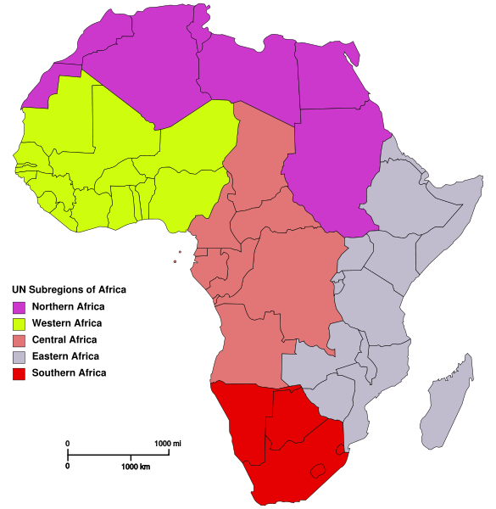

Slide 5
Major geographical features
Rivers: Nile, Congo, Zambezi, Niger
Mountains: Atlas, Mount Kilimanjaro
Deserts: Sahara, Namib
Others: Lake Victoria, Ethiopian Highlands, Congo Basin, Cape of Good Hope, Mozambique Channel, Sahel, Strait of Gibraltar.

Slide 6
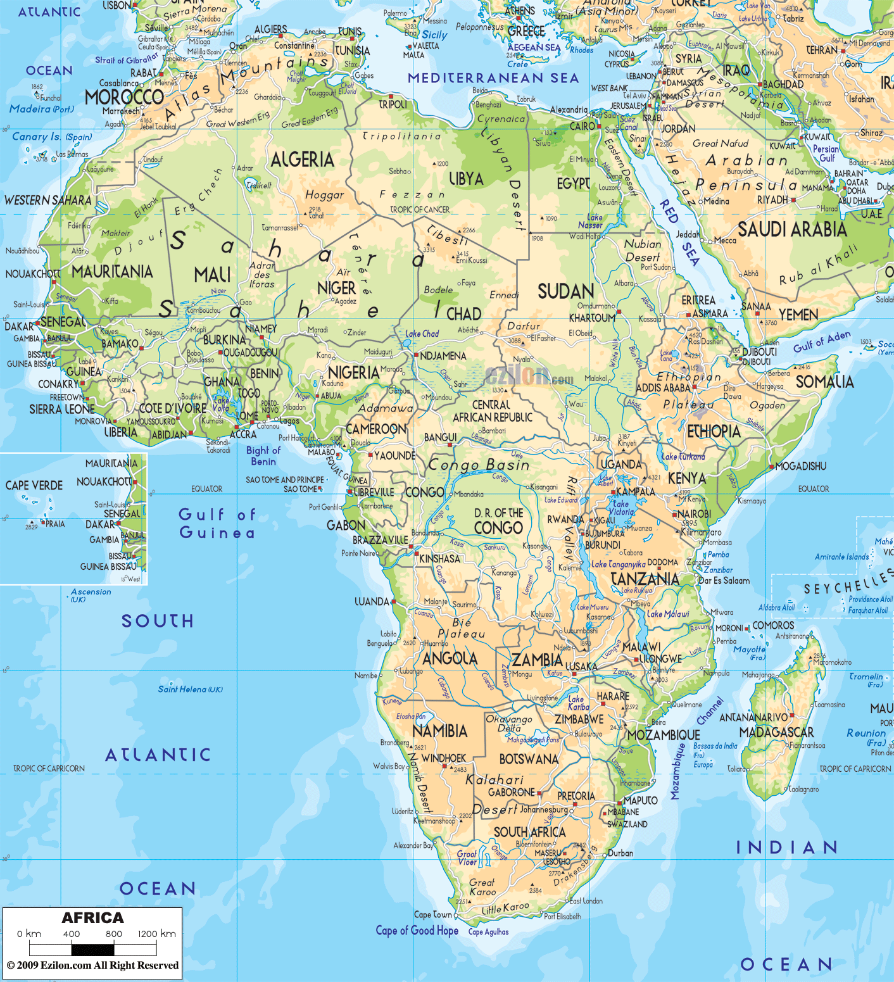

Slide 7
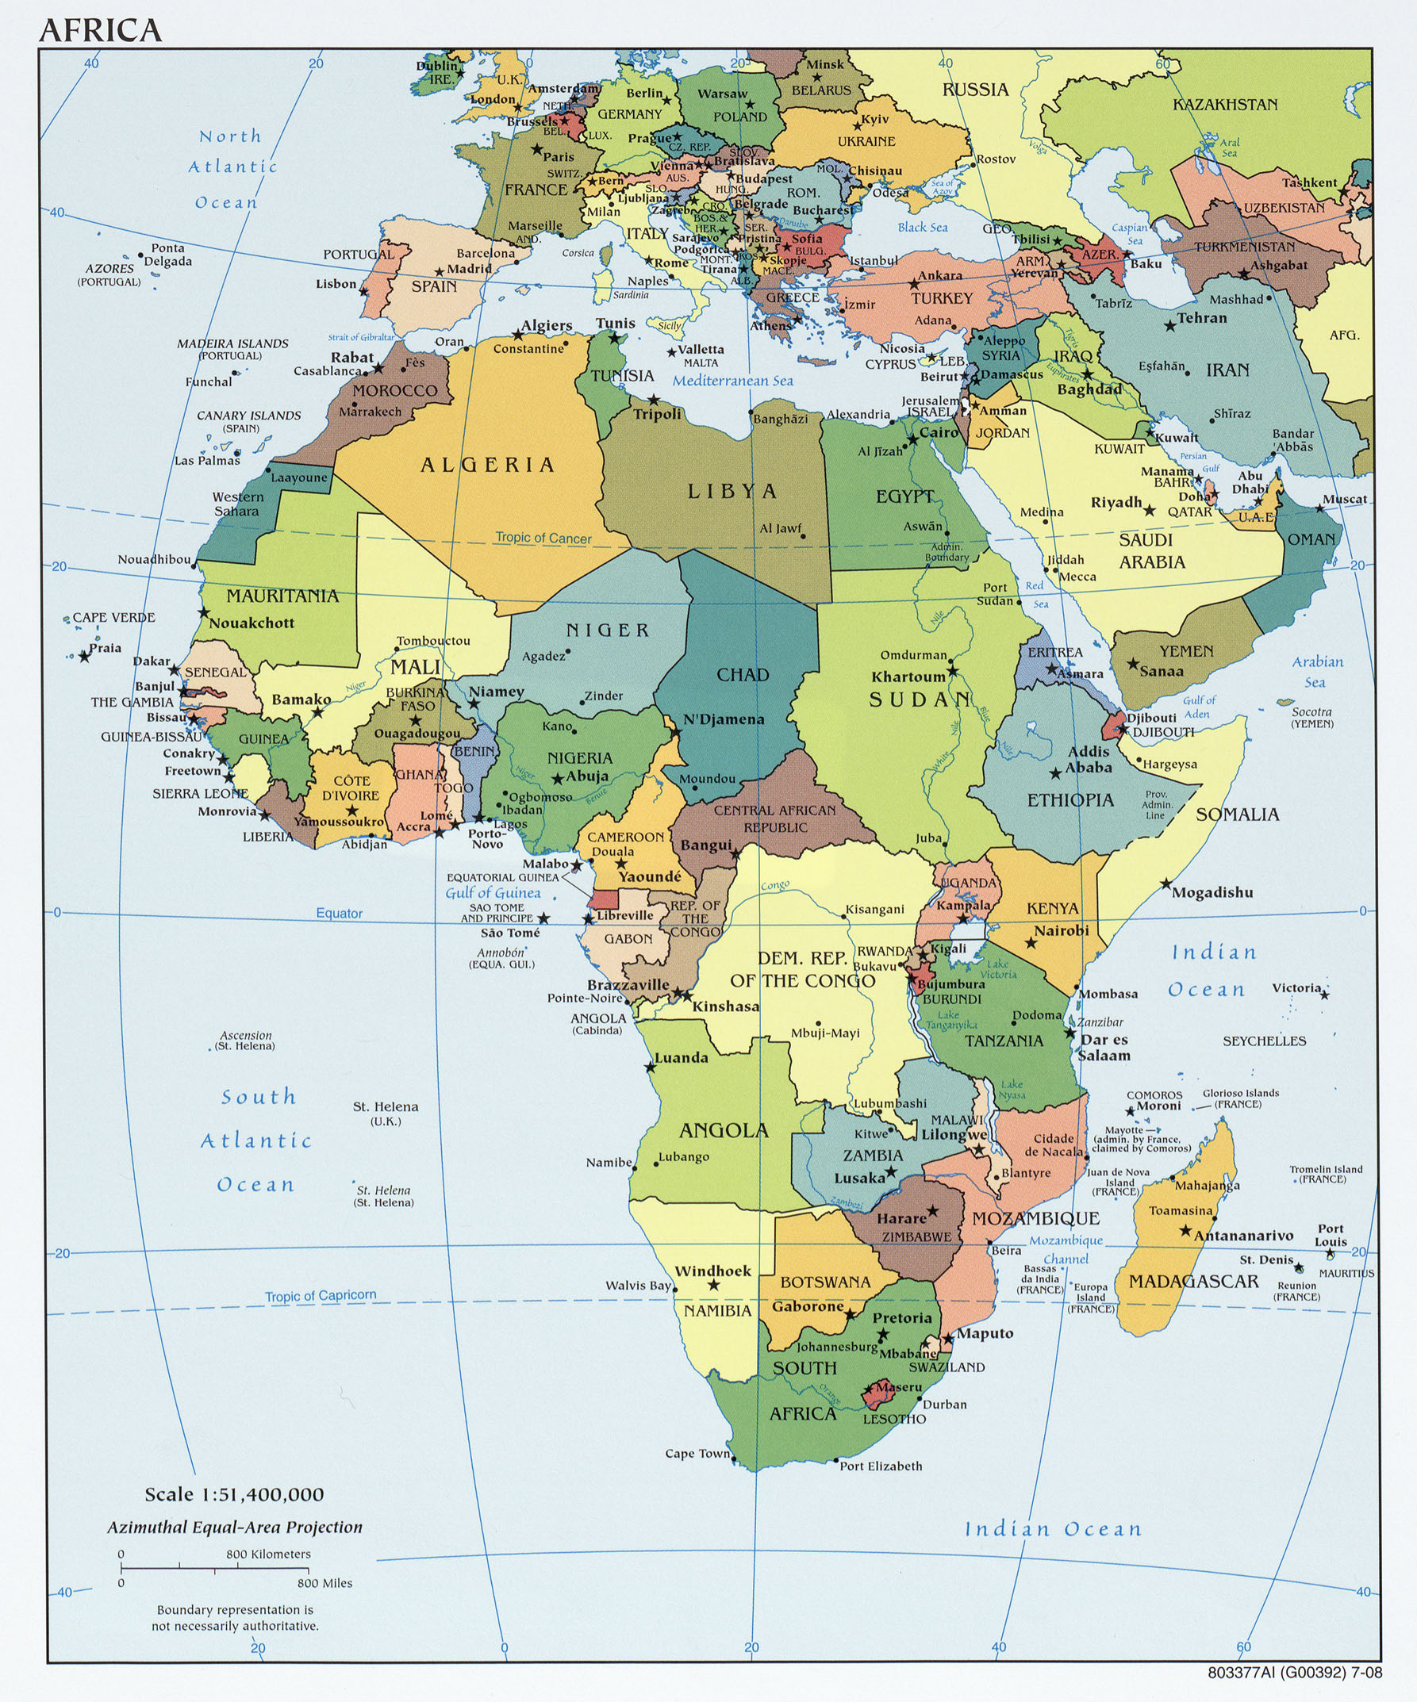
POLITICAL

Slide 8
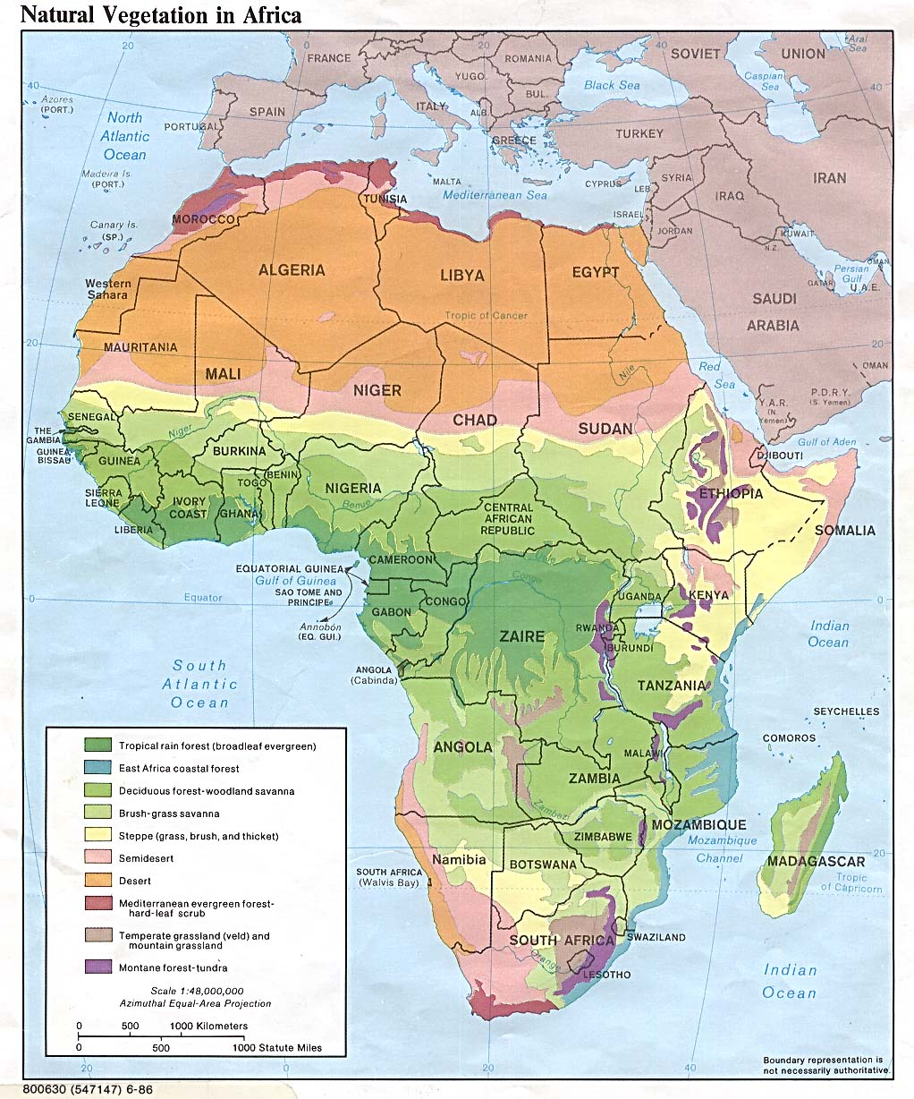

Slide 9
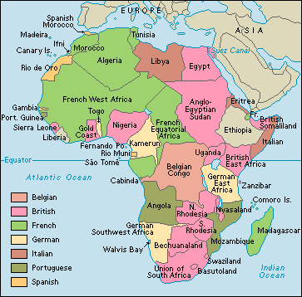
COLONIZATION

Slide 10
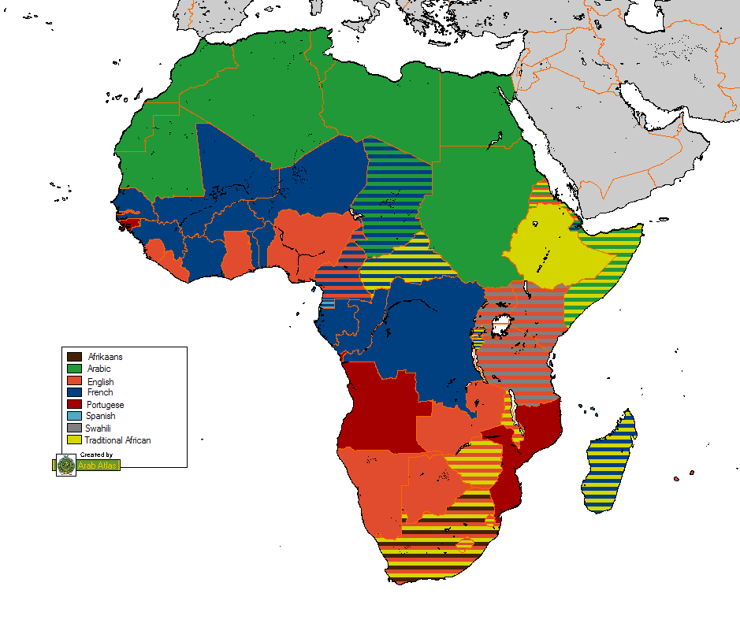

Slide 11
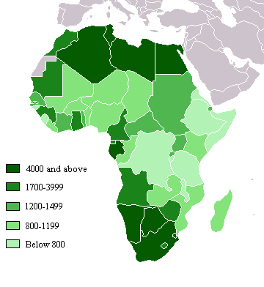
Gross Domestic Product (G.D.P.)

Slide 12
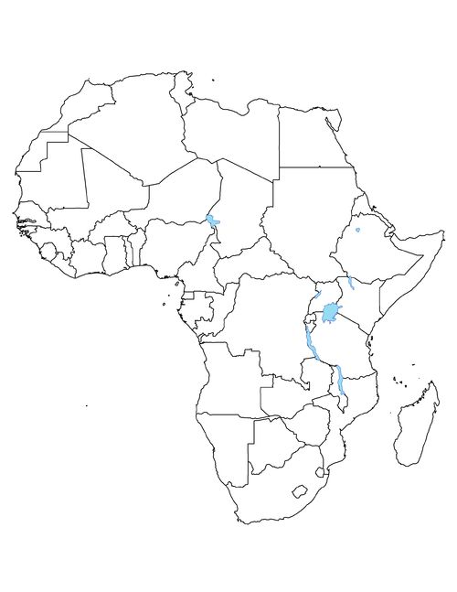
Physical Characteristics
Nile River (blue)
Sahara Desert (yellow)
Congo River (blue)
Lake Victoria
Niger River (blue)
Zambezi River (blue)
Ethiopian Highlands (brown)
Use colored pencils to mark these places.

